Slide 1
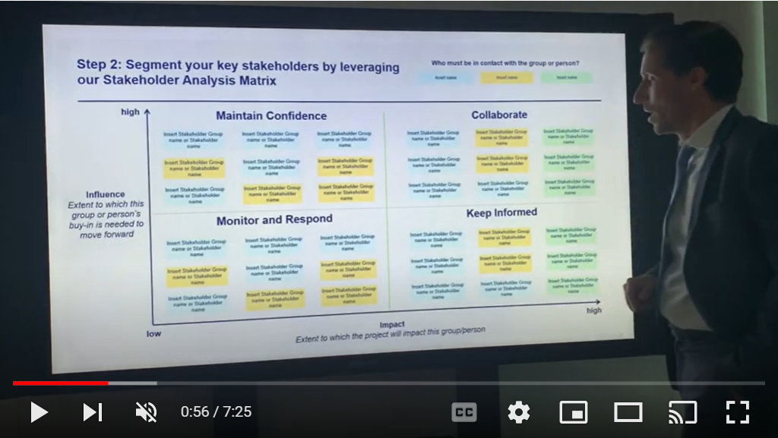
Private Video Training Stakeholder Analysis
Select “Slide Show” mode and then click on the image below to access this private video training.
You can also access the video by copy pasting the following URL in your browser:
https://youtu.be/-7nMV7I-3_I

